Slide 1
Dynamic Memory & Linked List
Prepared by: Afaq Mansoor Khan
BSSE III- Group A
Session 2017-21
IMSciences, Peshawar.

Slide 2
Last Lecture Summary
Selection Sort,
Insertion Sort,
Algorithms Analysis
Merge Sort Algorithm,
Merge Sort Analysis

Slide 3
Objectives Overview
Dynamic Memory Allocation
Introduction to Linked List

Slide 4
Problem with Arrays
Sometimes
Amount of data cannot be predicted beforehand
Number of data items keeps changing during program execution
Example: Search for an element in an array of N elements
One solution: find the maximum possible value of N and allocate an array of N elements
Wasteful of memory space, as N may be much smaller in some executions
Example: maximum value of N may be 10,000, but a particular run may need to search only among 100 elements
Using array of size 10,000 always wastes memory in most cases

Slide 5
Better Solution
Dynamic memory allocation
Know how much memory is needed after the program is run
Example: ask the user to enter from keyboard
Dynamically allocate only the amount of memory needed

Slide 6
Memory Allocation
There are essentially two types of memory allocation
Static
Dynamic

Slide 7
Memory Allocation - Static
Static – Done by the compiler automatically (implicitly).
Global variables or objects -- memory is allocated at the start of the program, and freed when program exits; alive throughout program execution
Can be access anywhere in the program.
Local variables (inside a routine) – memory is allocated when the routine starts and freed when the routine returns.
A local variable cannot be accessed from another routine.
Allocation and free are done implicitly.
No need to explicitly manage memory is nice, but has limitations!
Using static allocation, the array size must be fixed.

Slide 8
Memory Allocation - Dynamic
Wouldn’t it be nice to be able to have an array whose size can be adjusted depending on needs.
Dynamic memory allocation deals with this situation.
Dynamic – Done explicitly by programmer.
Programmer explicitly requests the system to allocate memory and return starting address of memory allocated (what is this?). This address can be used by the programmer to access the allocated memory.
When done using memory, it must be explicitly freed.

Slide 9
Explicitly allocating memory in C++: The ‘new’ Operator
Used to dynamically allocate memory
Can be used to allocate a single variable/object or an array of variables/objects
The new operator returns pointer to the type allocated
Before the assignment, the pointer may or may not point to a legitimate memory
After the assignment, the pointer points to a legitimate memory.

Slide 10
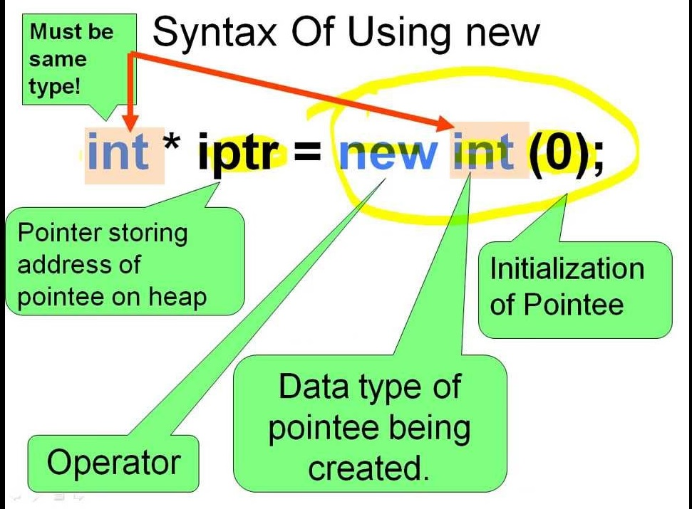

Slide 11
Explicitly freeing memory in C++: The ‘delete’ Operator
Used to free memory allocated with new operator
The delete operator should be called on a pointer to dynamically allocated memory when it is no longer needed
Can delete a single variable/object or an array
delete PointerName;
delete [] ArrayName;
After delete is called on a memory region, that region should no longer be accessed by the program
Convention is to set pointer to deleted memory to NULL
Any new must have a corresponding delete --- if not, the program has memory leak.
New and delete may not be in the same routine.

Slide 12
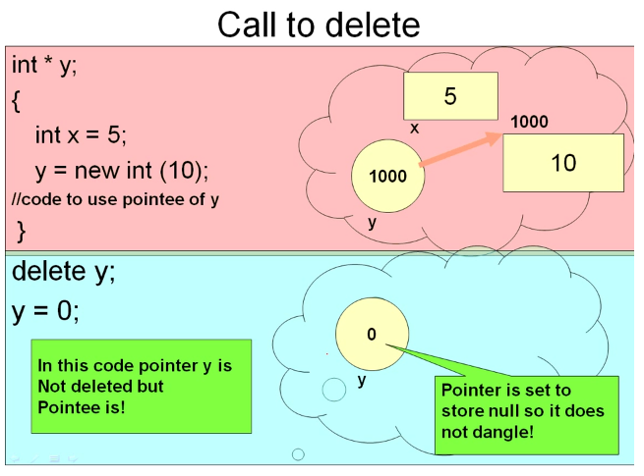

Slide 13
Example
int main()
{
// Below variables are allocated memory
// dynamically.
int *ptr1 = new int;
int *ptr2 = new int[10];
// Dynamically allocated memory is
// deallocated
delete ptr1;
delete [] ptr2;
}

Slide 14
The Heap
Large area of memory controlled by the runtime system that is used to grant dynamic memory requests.
It is possible to allocate memory and “lose” the pointer to that region without freeing it. This is called a memory leak.
A memory leak can cause the heap to become full
If an attempt is made to allocate memory from the heap and there is not enough, an exception is generated (error)

Slide 15
Why use dynamic memory allocation?
Allows data (especially arrays) to take on variable sizes (e.g. ask the user how many numbers to store, then generate an array of integers exactly that size).
Allows locally created variables to live past end of routine.
Allows us to create many structures used in Data Structures and Algorithms

Slide 16
The . and -> operators
The dot operator is used to access an object’s members
M1.Simplify();
M1.num = 5;
But how do we access an objects members if we only have a pointer to the object?
If we have M1_ptr = &M1, Perhaps we would use (*(M1_ptr)).Simplify()
A shorthand for this is the arrow operator
M1_ptr->Simplify() is equivalent to(*(M1_ptr)).Simplify()

Slide 17
Introduction to Linked Lists

Slide 18
Linked Lists
Linked List is a very commonly used linear data structure which consists of group of nodes in a sequence.
Each node holds its own data and the address of the next node hence forming a chain like structure.
Linked Lists are used to create trees and graphs.

Slide 19
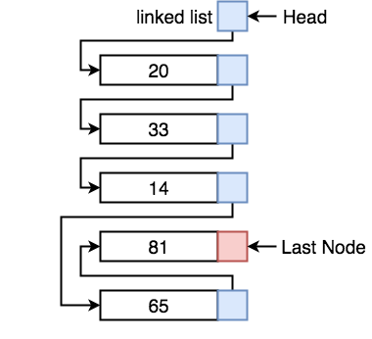
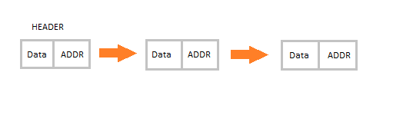
Linked List Representation

Slide 20
Types of Linked Lists
There are 3 different implementations of Linked List available, they are:
Singly Linked List
Doubly Linked List
Circular Linked List

Slide 21
Singly Linked List
Singly linked lists contain nodes which have a data part as well as an address part i.e. next, which points to the next node in the sequence of nodes.
The operations we can perform on singly linked lists are insertion, deletion and traversal.

Slide 22
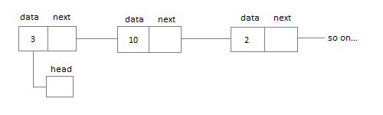

Slide 23
Doubly Linked List
In a doubly linked list, each node contains a data part and two addresses, one for the previous node and one for the next node.

Slide 24
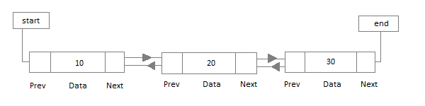

Slide 25
Circular Linked List
In circular linked list the last node of the list holds the address of the first node hence forming a circular chain.

Slide 26
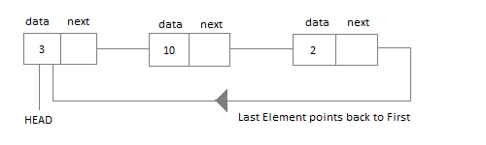

Slide 27
Advantages of Linked Lists
They are a dynamic in nature which allocates the memory when required.
Insertion and deletion operations can be easily implemented.
Linked List reduces the access time.

Slide 28
Disadvantages of Linked Lists
The memory is wasted as pointers require extra memory for storage.
No element can be accessed randomly; it has to access each node sequentially.
Reverse Traversing is difficult in linked list.
Not cache friendly. Since array elements are contiguous locations, there is locality of reference which is not there in case of linked lists.

Slide 29
Applications of Linked Lists
Linked lists are used to implement stacks, queues, graphs, etc. Linked lists let you insert elements at the beginning and end of the list. In Linked Lists we don't need to know the size in advance

Slide 30
Array vs Linked List
Both Linked List and Array are used to store linear data of similar type, but an array consumes contiguous memory locations allocated at compile time, i.e. at the time of declaration of array, while for a linked list, memory is assigned as and when data is added to it, which means at runtime.

Slide 31
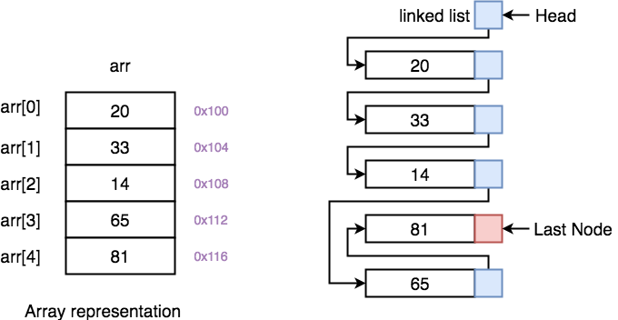
On the left, we have Array and on the right, we have Linked List.

Slide 32
Summary
Dynamic Memory Allocation
New Operator
Delete Operator
Heap
dot . and -> operators
Introduction to Linked List
Types
Advantages
Disadvantages
Applications
Difference between Array and Linked List

Slide 33
References
https://www.geeksforgeeks.org/what-is-dynamic-memory-allocation/
https://www.geeksforgeeks.org/new-and-delete-operators-in-cpp-for-dynamic-memory/
https://www.youtube.com/watch?v=texoDnnzWao
https://www.studytonight.com/data-structures/introduction-to-linked-list
https://www.geeksforgeeks.org/linked-list-set-1-introduction/

